Slide 1
Videos of Prototypes

Slide 2
Aric’s current spoon while eating cereal equivalent:
**Note: These beads are less thick and the bowl is deeper than Aric probably uses.

Slide 3
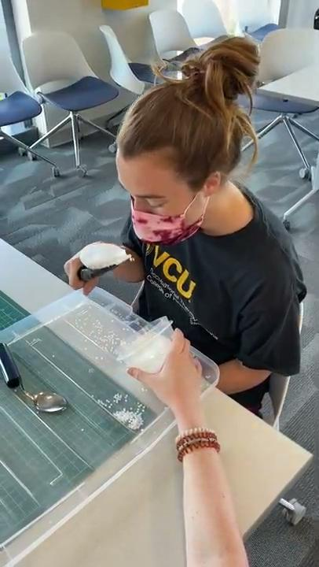
Prototype spoon while eating cereal equivalent:
*Note how the beads only come out the funnel at the end.

Slide 4
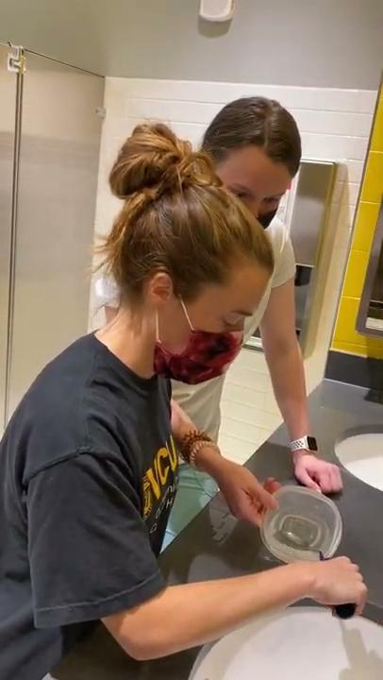
Aric’s current spoon while eating a thin liquid:

Slide 5
Prototype spoon while eating a thin liquid:
*Note how the water only comes out the funnel at the end.

Slide 6
How to clip-on prototype #2

